Slide 1
Arithmetic Logic Unit

Slide 2
Project Members:
Yassmine Ahmed abdl-basset
Menna Ashraff
Amira Ibrahim
Sultan Ibrahim
Anas Ahmed

Slide 3
Our ALU project can do three main operations:
Logic
Arithmetic
Shifting

Slide 4
ALU Operations:
ADD
SUBTRACT
MULTIPLY
INCREMENT(+1)
DECREMENT(-1)
AND
NAND
OR
NOR
SHIFT RIGHT
SHIFT LEFT

Slide 5
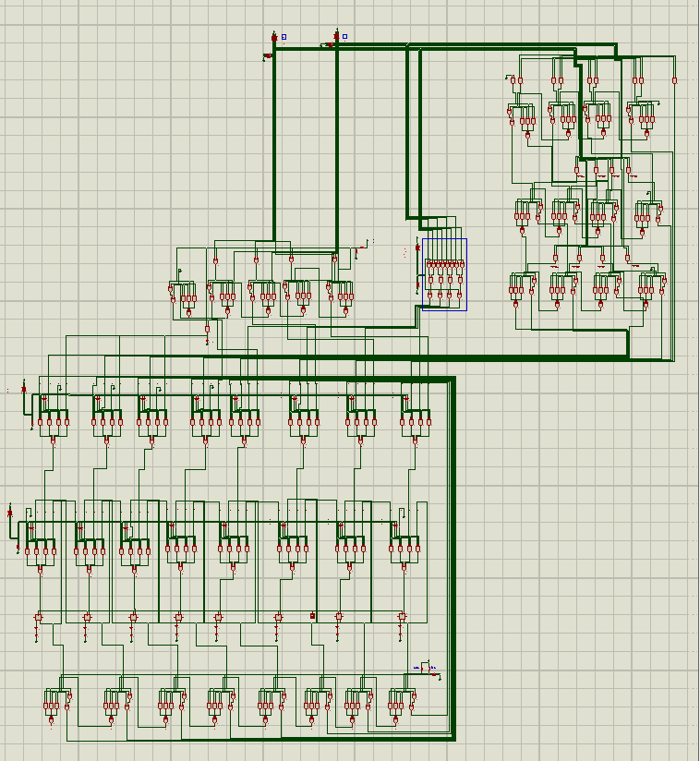
The design:

Slide 6
Quick overview.
First we take the input from the two 4-bit DIPSW_4.
The input is then applied to all three FULL ADDER , LOGIC and MULTIPLIER circuit at the same time.
The first Multiplexer level decides which of the three circuits output to take.
The second level of the Multiplexers is for the register’s operations.
At the end of the design we find 8-bit FULL ADDER which will be doing the incrementing and decrementing on the number in the registers.

Slide 7
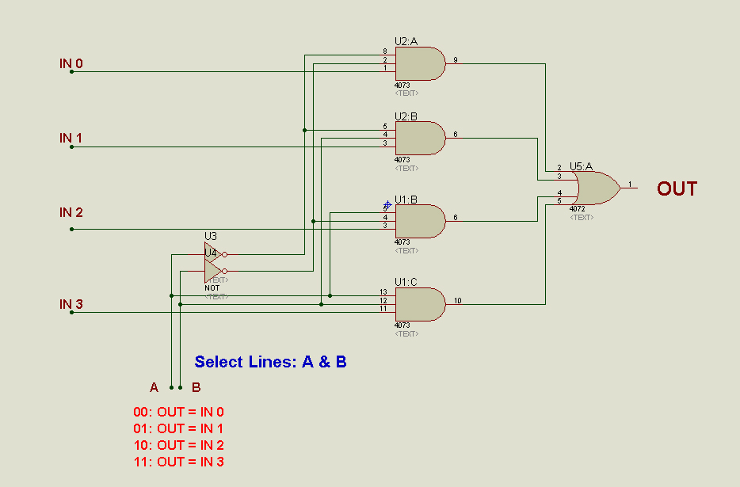
Multiplexer 4x1

Slide 8
Logical:

Slide 9
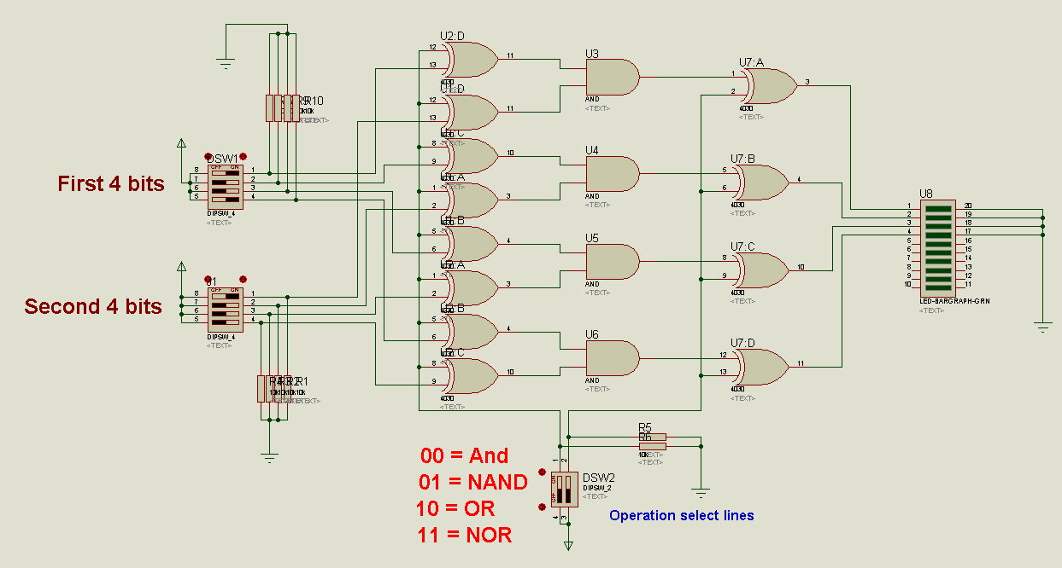
AND/NAND/OR/NOR :

Slide 10
How it works?
AND: S0=0,S1=0 -> two rows of XOR work as buffers -> AND operation.
NAND: S0=0 -> 1st XOR row work as buffer -> AND S1=1-> 2nd XOR row work as inverter-> NAND
OR: S0=1->1st XOR row work as inverter->OR S1=0->2nd XOR row work as buffer-> OR
NOR: S0=1->1st XOR row work as inverter->OR S1=1->2nd XOR row work as inverter->XOR
S0 | S1 | Operation
0 | 0 | AND
0 | 1 | NAND
1 | 0 | OR
1 | 1 | NOR

Slide 11
Arithmetic:

Slide 12
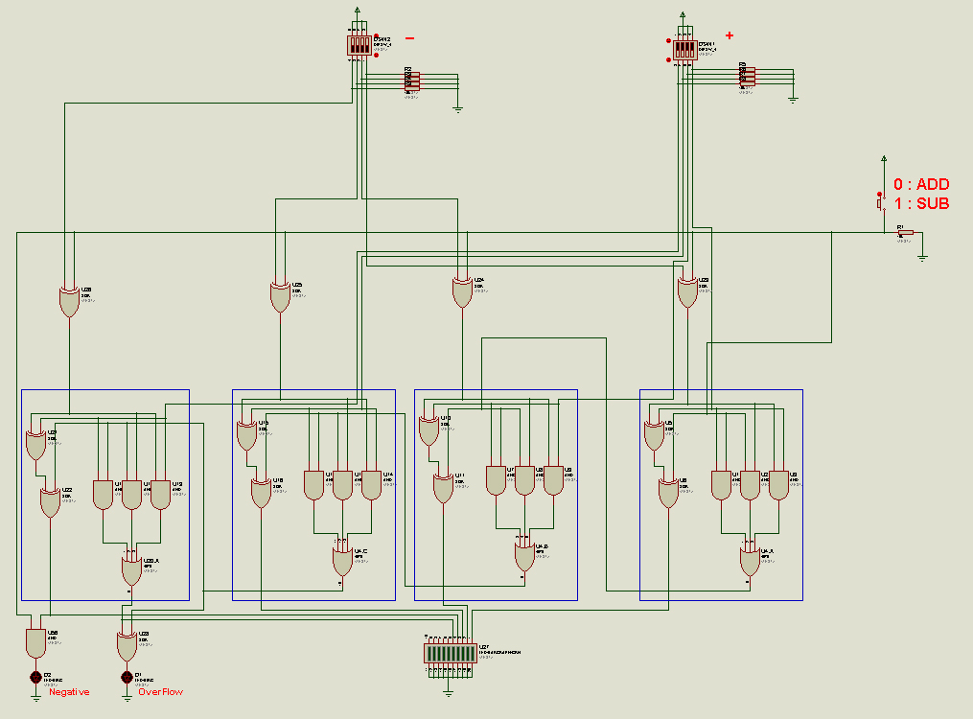
4-bit ripple Adder/Subtractor:

Slide 13
How it works?
Two binary words each of 4 bit can be added using a ripple adder
Each stage add 1 bit.
For subtraction, get 2’s complement for B by getting 1’s complement and adding 1.
So we use XOR : in case M=0 -> Buffer -> adding in case M=1->Inverter->subtract
Overflow in case : C3=! C4, for detection use XOR

Slide 14
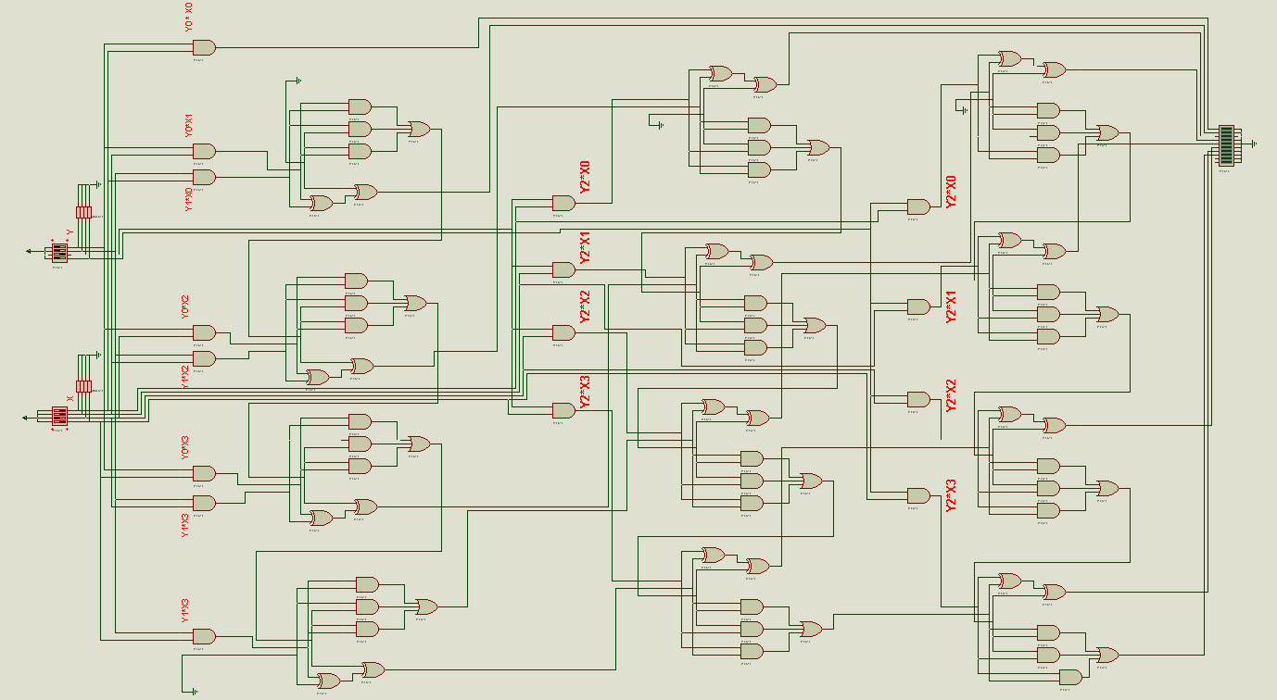
Multiplication:

Slide 15
How it works?
For 4x4 -> 8bit Maximum result.
It require 4x4=16 AND gates to generate this product.
The multiplication unite uses “multiplication by addition”.
It uses 3*(4-bit Full Adder)
 |  |  | X3 | X2 | X1 | X0
 |  |  | Y3 | Y2 | Y1 | Y0
 |  |  | Y0*X3 | Y0*X2 | Y0*X1 | Y0*X0
 |  | Y1*X3 | Y1*X2 | Y1*X1 | Y1*X0
 | Y2*X3 | Y2*X2 | Y2*X1 | Y2*X0
Y3*X3 | Y3*X2 | Y3*X1 | Y3*X0

Slide 16
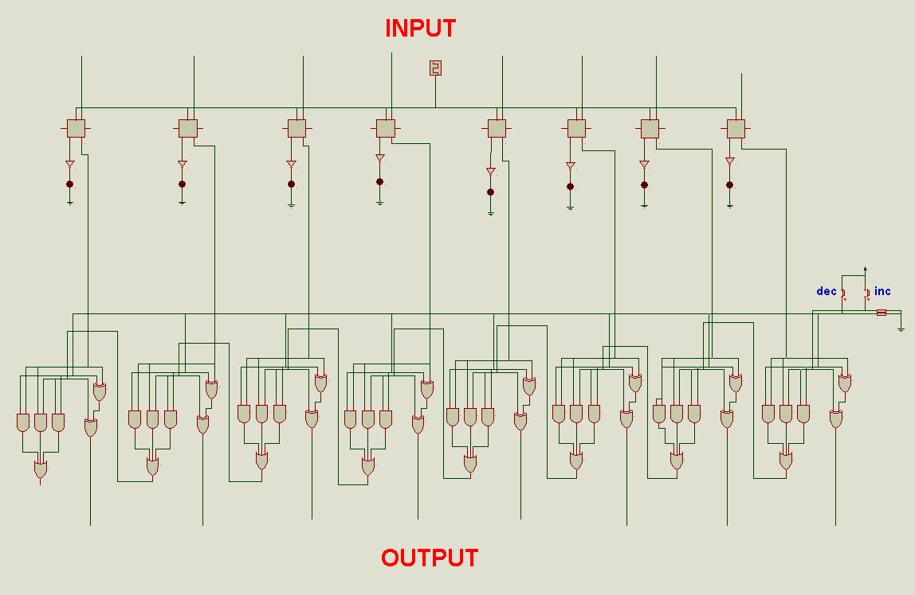
Increment & Decrement +/- 1

Slide 17
How it works?
It’s uses 8-bit Full Adder.
Increment: load number in memory (A) put logic 1 on the first carry and 0 on second number (B)
Decrement: load number in memory (A) put logic 1 on all (B) bits “-1” and 0 on the first carry (C0)
Send the output result back to the memory.

Slide 18
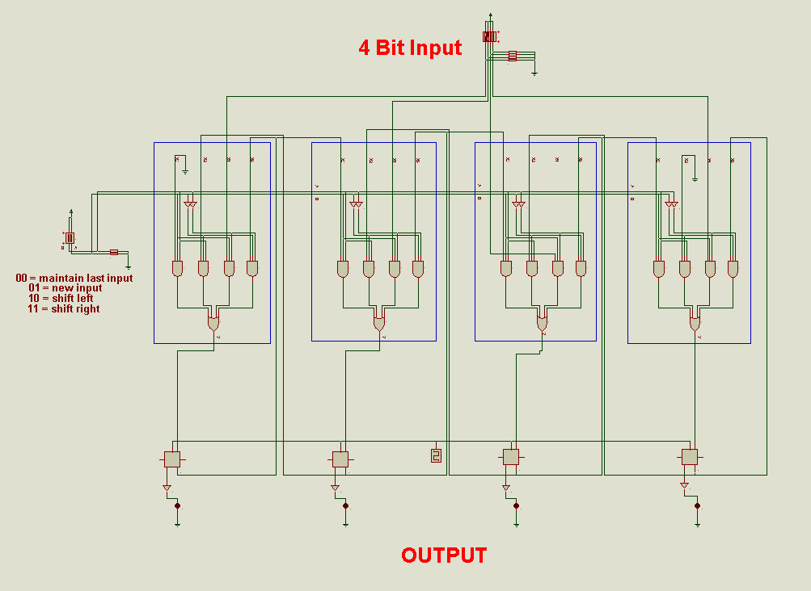
Shifting:

Slide 19
How it works?
As we are performing 4 operations: two switches needed (S0,S1)
To switch between operations : 4:1MUX is used.
S0 | S1 | Operation
0 | 0 | Maintain
0 | 1 | New input
1 | 0 | Shift right
1 | 1 | Shift left

